Slide 1

CALIFORNIA HOUSING

Slide 2
OBJECTIVES
CLEANING
Cleaning the dataset to make sure they are no null values in it.
UNDERSTANDING
Understanding the dataset and analyzing every column and their relations with each other.
GETTING
Getting the visualizations for every attribute in the dataset.
PERFORMING
Performing Sampling for a column to perceive the difference between sample and population
EXECUTING
Executing some of the probability and statistical related analysis to get an overview of the data.
IDENTIFYING
Identifying the distribution of attributes and obtain the confidence intervals for population.
CARRYING
Carrying Hypothesis testing procedure to evaluate which hypothesis is best supported by the sample data.

Slide 3
ATTRIBUTES
Latitude and Longitude which are used to specify the location.
HousingMedianAge : Median age of the house with in a block. A lower number specifies the newer Building.
TotalRooms : Total number of rooms within a block.
TotalBedRooms : Total number of bed rooms within a block.
Population : Total number of people residing in a block.
Households : Total number of households for a block.
MedianIncome : Median Income per month for the households within a blocks of houses(measured in thousands of US dollars)
MedianHouseValue : Median house value for households with in a block(measured in tens US dollars)

Slide 4
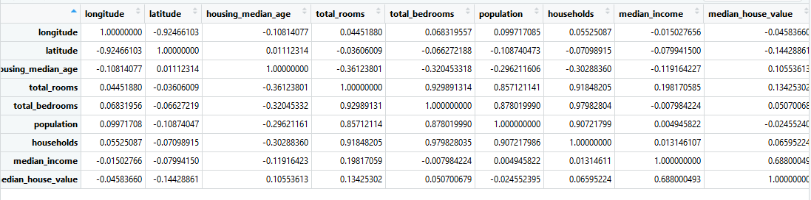
CORRELATION COEFFICIENT
DATA CLEANING
Made sure that the dataset does not contain any nulls.
CORRELATION COEFFICIENTS FOR UNDERSTANDING THE DATASET

Slide 5
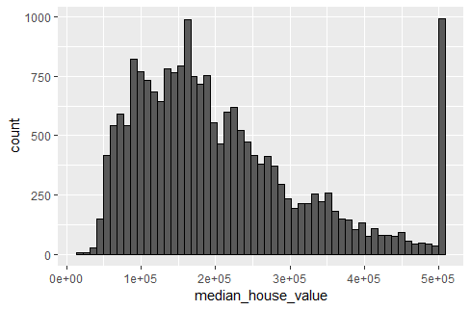
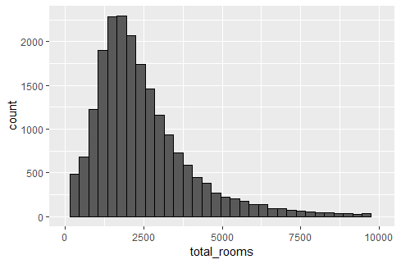
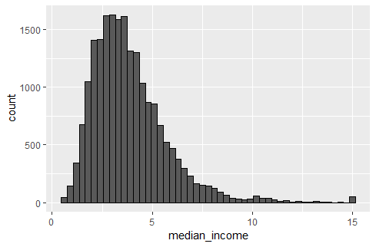
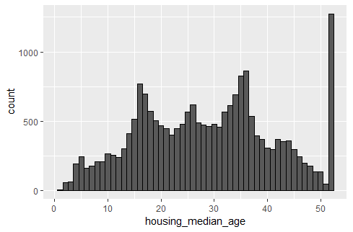
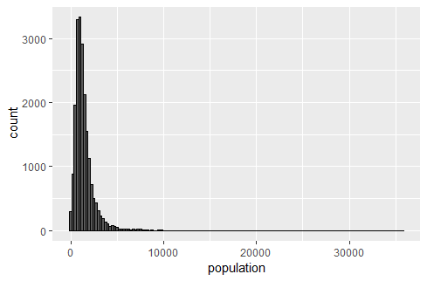
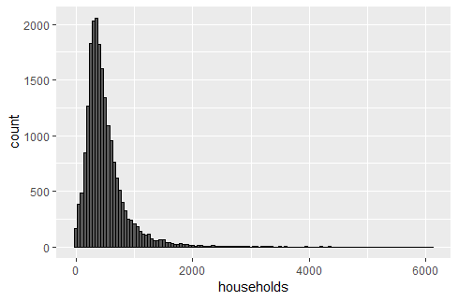
HISTOGRAMS FOR ATTRIBUTES

Slide 6
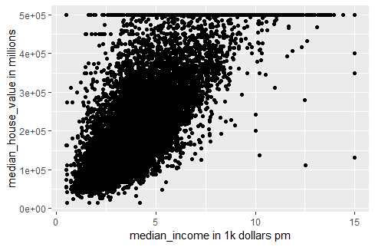
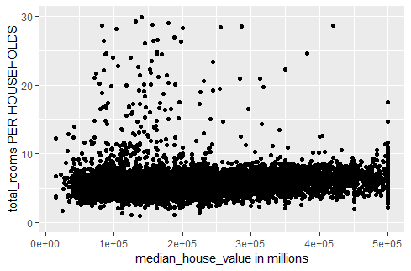
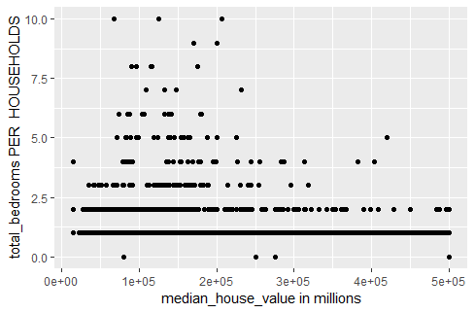
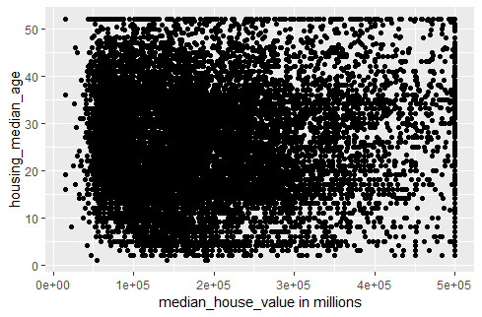
AFTER GROUPING THE DATA BY LATITUDE AND LONGITUDE

Slide 7
SAMPLING
Assumed our data set as population data
Considered sample size as 100 for comparing
For median_house_age column
Mean of housing_median_age = 28.63889
Standard deviation = 12.58557 years
From the sample of 100, we got
Mean = 28.63387 years
Standard deviation = 1.284474 years
Almost the same mean values for both sample and population data.
Now we tried for median_house value to identify the difference between sample and population data.
Population Mean =$ 206843.9
Variance = 13313867080
Sample data of 100
Mean = $ 205813.5
Variance = 145421770

Slide 8
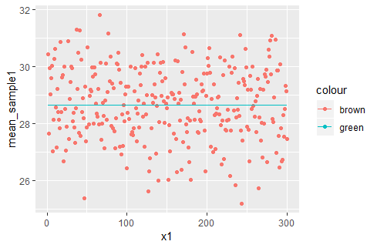
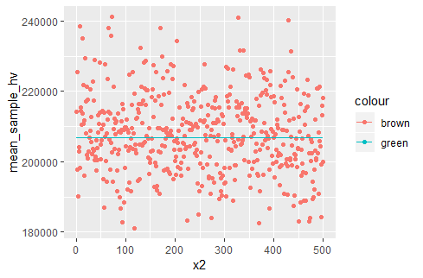
REPRESENTATION OF MEANS OF SAMPLES VS POPULATION DATA

Slide 9
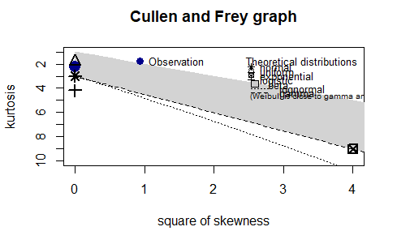
GOODNESS OF FIT TESTS
DESCRIPTIVE STATISTICS AND GOODNESS OF FIT GRAPH FOR HOUSING_MEDIAN_AGE:
CONSIDERED NORMAL
Fitting of the distribution ' norm ' by maximum likelihood
Parameters :
estimate Std. Error
mean 28.63889 0.08760280
sd 12.58526 0.06194453
Loglikelihood: -81554.29 AIC: 163112.6 BIC: 163128.4
Correlation matrix:
mean sd
mean 1 0
sd 0 1
From the above graph we can observe that the observation(blue dot) is between normal and uniformdistribution.
To check for the perfect distribution between these uniform and normal distribution we will compare theparameters of the fitting distribution. After considering those parameters we will decide which one is best.
In the above case normal distribution is the perfect distribution.

Slide 10
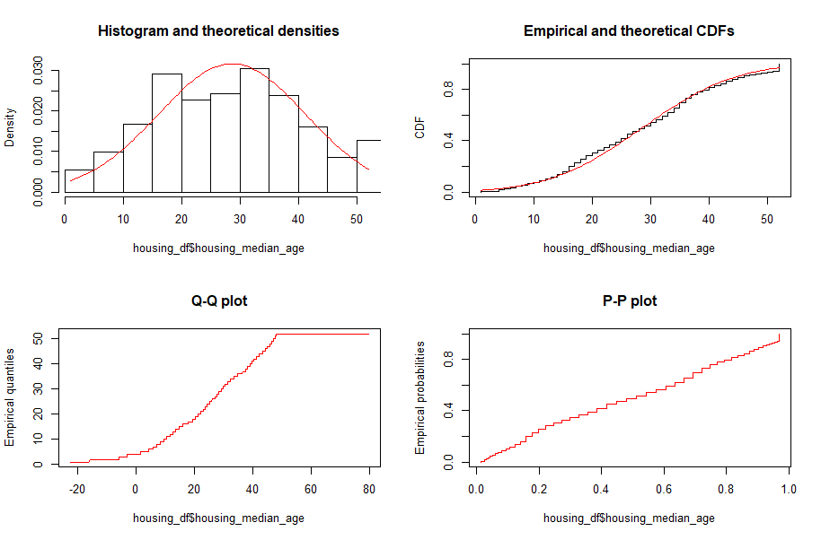

Slide 11
CONFIDENCE INTERVAL FOR HOUSING_MEDIAN_AGE
Sample mean= 28.6692
Error = 2.367086
Left = 26.15451
Right = 30.88869
From the above values it can concluded that the confidence interval is 26.15451< population mean < 30.88869 for 97% CI.
Standard deviation = 12.58557
Sample size =100

Slide 12
Hypothesis testing
we are using this one sample z test because we know the population variance and population for median_house_age is normally distributed.
Defining Hypothesis:
Null Hypothesis(H0): μ = μ0
The mean of the population is equal to the mean of the sample.
Alternate Hypothesis(Ha): μ!= μ0
Mean of the population is not equal to the sample mean.

Slide 13
Hypothesis testing
Step 1: Creating a sample
We already created a sample and we are using the same sample
Step 2: Considering the significance value is alpha=0.01
Step 3: Calculating the value of z
Z =0.01039216 from R
Since the z-value lies within the range [−1.96, 1.96], we thus fail to reject null hypothesis.
Conclusion is that there is no significant difference between sample's housing_median_age and population's housing_median_age.

Slide 14
THANK YOU
PAVAN KUMAR REDDY
DILIP PUROHIT
LING ZHAO

